Slide 1
CSE 12 Week 4 Discussion
10-27-20
Focus: Counting Step & Runtime Analysis

Slide 2
Reminders
PA3 due tomorrow at 11:59 PM
PA4 is released Thursday, is an open assignment - collaborate!
PA1 Resubmission due Friday, October 30th 11:59 PM
PA2 Resubmission due Thursday, November 5th 11:59 PM

Slide 3
Do you feel prepared for the Midterm?
A. Going to ace it!
B. Almost there
C. ¯\_(ツ)_/¯
D. not ready at all
E. What midterm?

Slide 4
Counting Steps...
100
50
25
10
How many times does the following loop run?
for (int i = 1; i < 1000; i*=2) {
System.out.println(i);
}

Slide 5
Answer - D
Loop index increments by a factor of 2 each iteration:
i = 1...2...4...8...16...32...64...128...256...512 (10 times total)
And fails to run when i = 1024 since i > 1000

Slide 6
Counting Steps...
We have a Linked List containing 10 nodes. If we are searching for “Jerry” using find() but the Linked List does not contain “Jerry”, how many times are we going to go through the while loop?
9
1
3
10
//LINKED LIST THAT HOLDS A STRING IN EACH NODE
boolean find(String toFind) {
Node current = this.front.next;
while(current != null) {
if(current.value.equals(toFind)) {return true;}
current = current.next;
}
return false;
}

Slide 7
Answer - D
Considering the LinkedList has 10 nodes, we will loop through all Nodes until a match is found.
There will be no match in this case since “Jerry” is not in the LinkedList.
We will therefore go through the loop 10 times to examine each Node.
//LINKED LIST THAT HOLDS A STRING IN EACH NODE
boolean find(String toFind) {
Node current = this.front.next;
while(current != null) {
if(current.value.equals(toFind)) {return true;}
current = current.next;
}
return false;
}

Slide 8
Loop Iterations vs Linked List Length
(when String to find is not in list)
Loop Iterations
Linked List Length

Slide 9
Counting Steps...
If we are still searching for “Jerry” and it is found in the LinkedList, how many times will the while loop run?
9
1
10
Can not be determined
//LINKED LIST THAT HOLDS A STRING IN EACH NODE
boolean find(String toFind) {
Node current = this.front.next;
while(current != null) {
if(current.value.equals(toFind)) {return true;}
current = current.next;
}
return false;
}

Slide 10
Answer - D
If “Jerry” is in the LinkedList, we do not know exactly how many Nodes from the start it is located.
It could be located at start of list, end, middle, anywhere...
//LINKED LIST THAT HOLDS A STRING IN EACH NODE
boolean find(String toFind) {
Node current = this.front.next;
while(current != null) {
if(current.value.equals(toFind)) {return true;}
current = current.next;
}
return false;
}

Slide 11
Counting Steps...
//FIND FIRST MATCHING VALUE ACROSS BOTH LISTS
String findMatch(LinkedList a, LinkedList b) {
Node aNode = a.first.next;
for (int i = 0; i < a.size; i++) {
Node bNode = b.first.next;
for (int j = 0; j < b.size; j++) {
if (aNode.value.equals(bNode.value) {
return aNode.value;
}
bNode = bNode.next;
}
aNode = aNode.next;
}
return null;
}
Assuming that there are no matches between the two Linked Lists a and b, how many times would the inner if statement be executed?
a.size
b.size
a.size * b.size
a.size + b.size
None of the above

Slide 12
Answer - C
//FIND FIRST MATCHING VALUE ACROSS BOTH LISTS
String findMatch(LinkedList a, LinkedList b) {
Node aNode = a.first.next;
for (int i = 0; i < a.size; i++) {
Node bNode = b.first.next;
for (int j = 0; j < b.size; j++) {
if (aNode.value.equals(bNode.value) {
return aNode.value;
}
bNode = bNode.next;
}
aNode = aNode.next;
}
return null;
}
The inner if statement is inside both for loops.
Outer for loop runs a.size times.
Inner for loop runs b.size times.
Anything inside inner for loop is called a.size * b.size times.

Slide 13
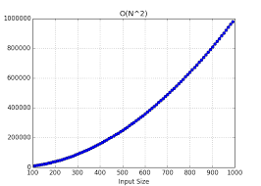
If Statement Calls vs List Sizes (when no items match across two lists)

Slide 14
Categorizing Runtimes

Slide 15
Let f(n) = 100
Which of the following is true?
f(n) is O(2^{n})
f(n) is O(n²)
f(n) is O(n)
All of these
None of these

Slide 16
Let f(n) = 100
Which of the following is true?
f(n) is O(2^{n})
f(n) is O(n²)
f(n) is O(n)
All of these
None of these

Slide 17
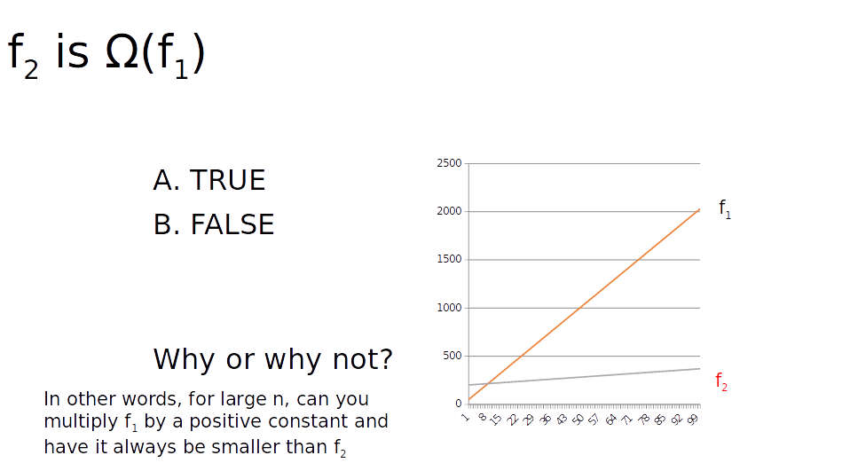
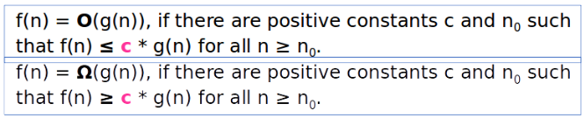

Slide 19
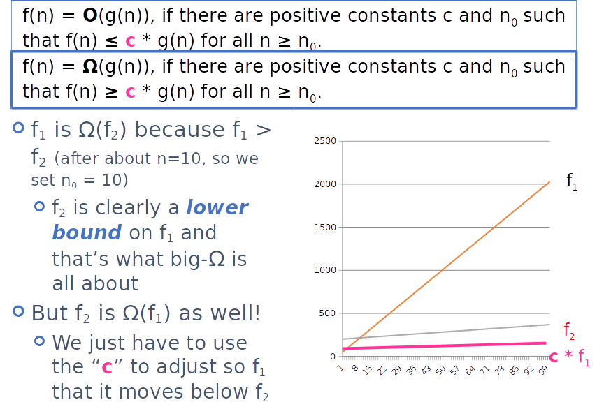

Slide 20
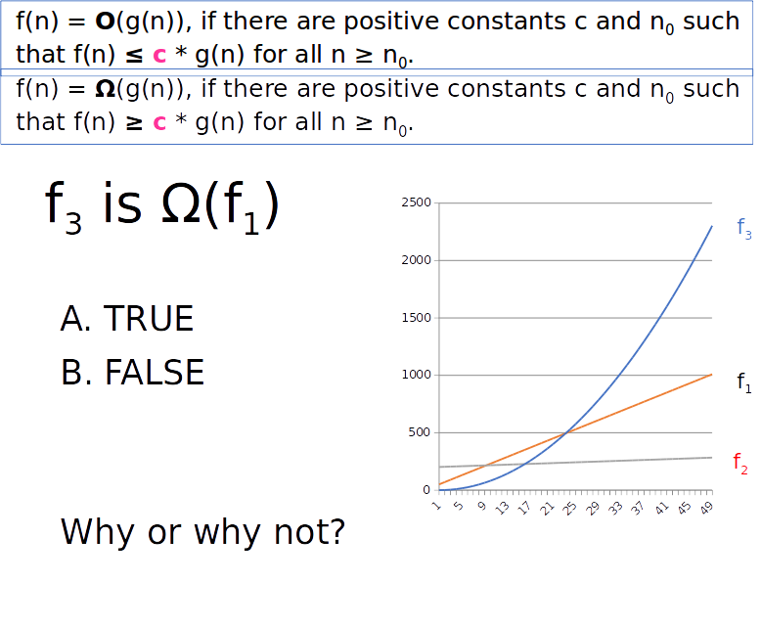

Slide 22
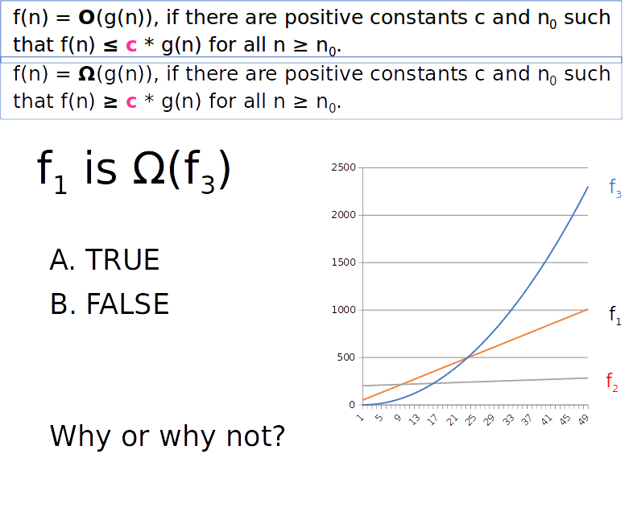

Slide 24
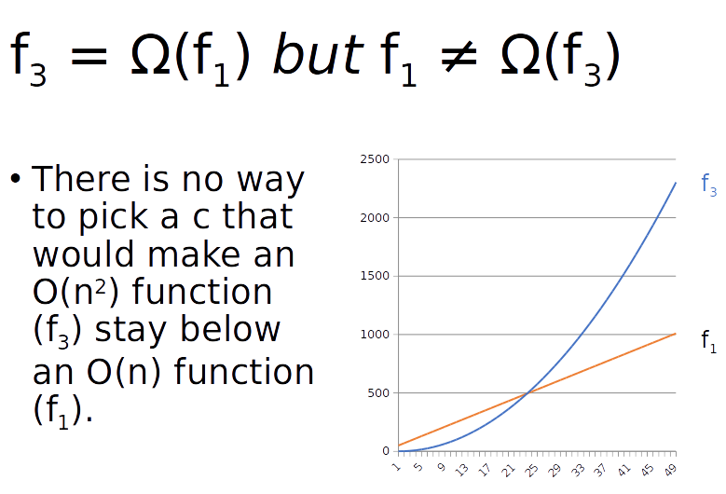

Slide 25
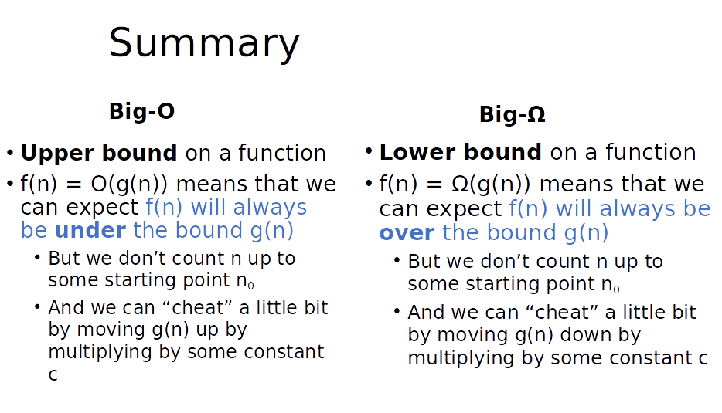

Slide 26
